Slide 1
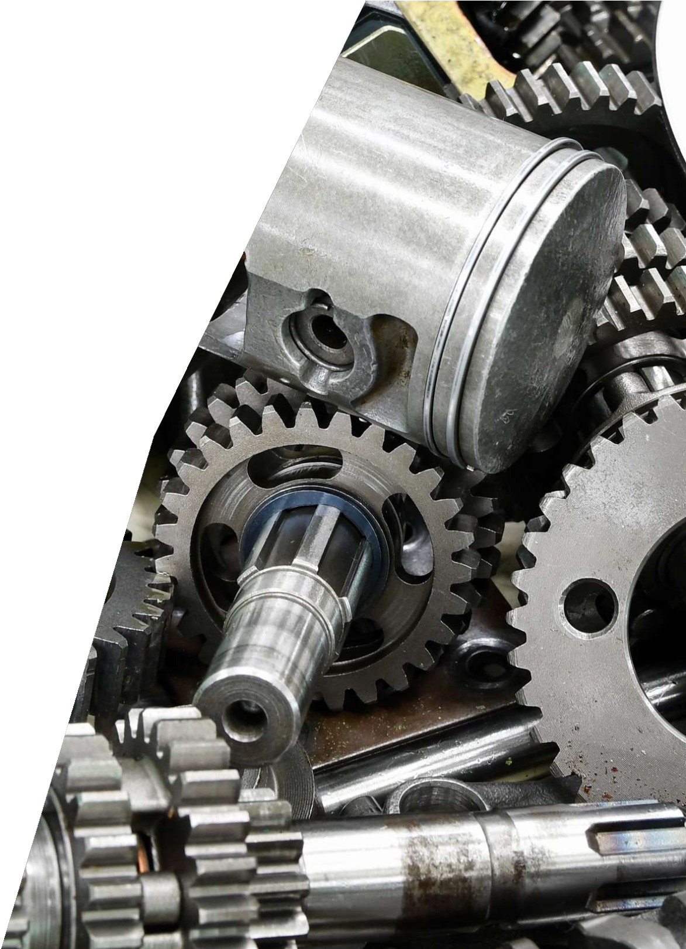
KUMAR EXPORTS
PITCH DECK

Slide 2
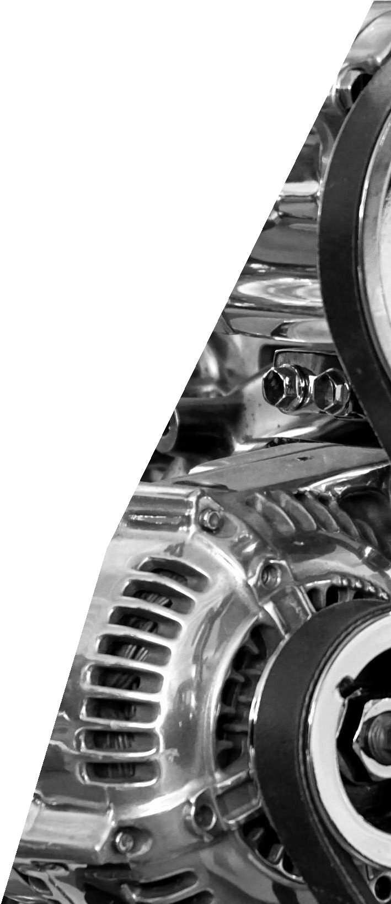
ABOUT US
Kumar Exports, a tiny entity that emerged in 1993, has established itself as a recognized export house specializing in the manufacturing and export of high-quality engineering goods. Over the years, the company has earned a reputation for excellence and has become a trusted name in the industry. All the group companies engaged in manufacturing are accredited to ISO/TS 16949 and ISO 14001 certifications, highlighting our commitment to quality and environmental standards.

Slide 3
MISSION
VISION
Kumar Exports aims to exceed customer expectations and set a benchmark for excellence in engineering products by
Kumar providing
Exports focuses on engineering solutions,
exceeding expectations, and
fostering innovation to customer satisfaction industry success.
improve
and
delivering high-quality services, investing in
products and innovation, and
fostering innovation.

Slide 4
GROUP COMPANIES
KUMAR EXPORTS :PRECISION MACHINE SHOP
C-180, PHASE –VI, EQUIPPED WITH CNC, HMC,
FOCAL POINT VMC MACHINES EQUIPPED WITH
LUDHIANA -141 010 ALL TESTING FACILITIES
INCLUDING CMM –MACHINING
CAPACITY -700X700X700
KUMAR EXPORTS(UNIT NO.2) : PRECISION FORGINGS
INDUSTRIAL AREA, G.T. ROAD, CAPACITY : 1.5 KG TO 70 KG
DORAHA –DISTT: LUDHIANA TESTING & HEAT TREATMENT
FACILITY AVAILABLE

Slide 5
KUMAR EXPORTS C-180, PHASE-VI,FOCAL POINT LUDHIANA -141010
GROUP COMPANIES
KUMAR EXPORTS INDUSTRIES PVT LIMITED
Precision Machine Shop Equipped with CNC,HMC,VMC Machines Equipped with All Testing Facilities including CMM-Machining Capacity 70x700x700
i

Slide 6
GROUP COMPANIES
KUMAR EXPORTS(UNIT NO.3) : PRE-MACHINING AND SURFACE
E-375, PHASE-VI, TREATMENT
FOCAL POINT, LUDHINA
KUMAR EXPORTS INDUSTRIES PVT LTD : PRECISION CASTING
INDUSTRIAL AREA, G.T. ROAD, ON HPML WITH ALL
DORAHA TESTING FACILITIES
BOX SIZE: 600MMX700MM
KUMAR AUTOCAST LIMITED : PRECISION CASTING ON ARPA LINE
C-179, PHASE-VI,FOCAL POINT WITH ALL TESTING FACILITIES
LUDHIANA INCLUDING RADIOGRAPHIC TESTING
BOX SIZE:785X785X660 (ALL SIZE
ARE IN MM )

Slide 7
PROBLEMS
QUALITY CONTROL
COST COMPETITIVENESS
Lack of reliable and high- quality engineering goods in
the market.
Limited cost reduction options for customers.
TECHNOLOGY
COMPLEXCITY
Inadequate access to advanced manufacturing
technologies.
Insufficient solutions for complex engineering product development.

Slide 8
GROUP COMPANIES
KUMAR EXPORTS :PRECISION MACHINE SHOP
C-180, PHASE –VI, EQUIPPED WITH CNC, HMC,
FOCAL POINT VMC MACHINES EQUIPPED WITH
LUDHIANA -141 010 ALL TESTING FACILITIES
INCLUDING CMM –MACHINING
CAPACITY -700X700X700
KUMAR EXPORTS(UNIT NO.2) : PRECISION FORGINGS
INDUSTRIAL AREA, G.T. ROAD, CAPACITY : 1.5 KG TO 70 KG
DORAHA –DISTT: LUDHIANA TESTING & HEAT TREATMENT
FACILITY AVAILABLE

Slide 9
SOLUTIONS
TECHNOLOGY
COMPLEXCITY
COMPETITIVE PRICING
COMMITMENT TO QUALITY
Manufacturing and exporting high- quality engineering goods.
Providing access to modernized machine shop capabilities, including HMC, VMC, and CNC turning.
Offering expertise in complex engineering product development.
Participation in value analysis and value engineering (VAVE) activities to provide cost-effective solutions.

Slide 10
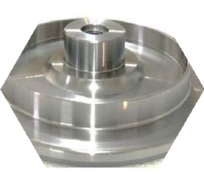
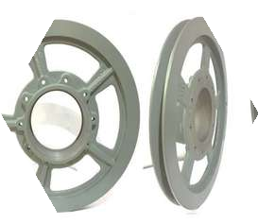
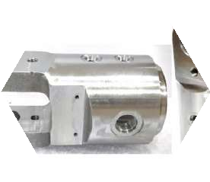
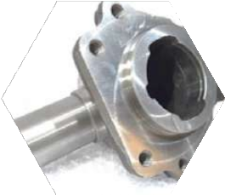
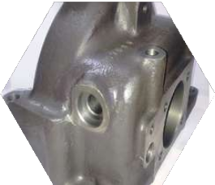
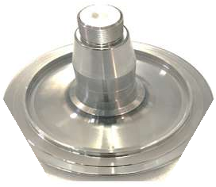
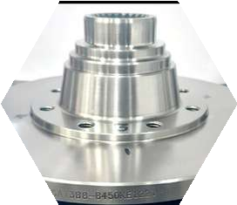
PRODUCTS
Assembly parts Agriculture machinery Railway parts
Automotive exhaust parts Automotive housings and covers
Automotive transmission parts
Blank forgings Earthmoving machinery parts
Automotive steering knuckles and aluminium lifting kits Automotive suspension parts

Slide 11
UNIQUE SELLING PROPOSITION
In-house casting, forging, and machining facilities.
Offers engineering product development solutions.
Modernized machine shop with advanced technologies.
Expertise team with a mix of youth and experience
In-house testing facilities for maintaining quality consistency.
Commitment to integrity and customer satisfaction

Slide 12
VALUE PROPOSITION
High-quality and services.
engineering
goods
Cost-effective solutions through participation in VAVE activities.
Emphasis on maintaining quality consistency.
Expertise engineering development
in complex product
Modernized machine shop with advanced technologies.
In-house manufacturing capabilities for casting, forging, and machining.

Slide 13
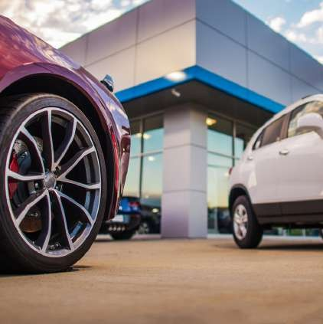
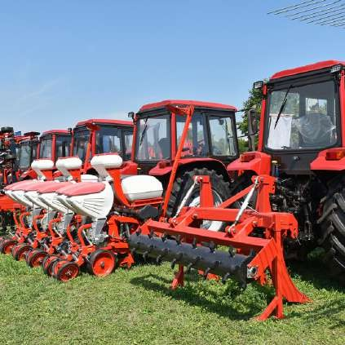
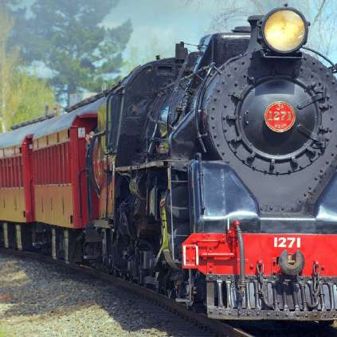
TARGET CUSTOMERS
Agriculture machinery manufacturers
Earthmoving machinery manufacturers
Railway equipment manufacturers
Automotive manufacturers

Slide 14
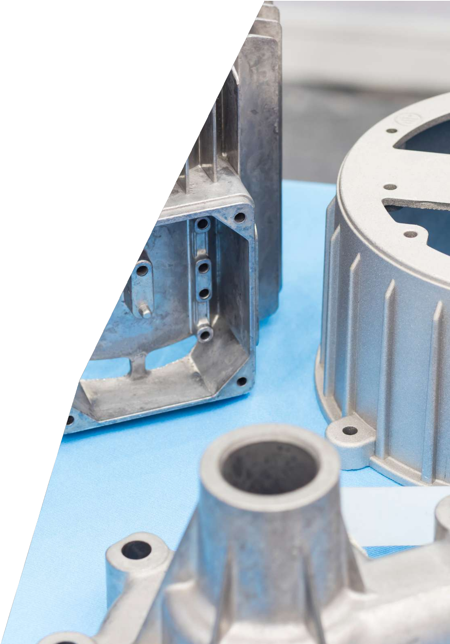
REVENUE MODEL
Manufacturing and exporting engineering goods generates revenue.
Increased revenue from value-added services like VAVE and reverse engineering.
Customized pricing based on product specifications and customer requirements.
Consistent revenue streams through long- term contracts with customers.

Slide 15
AIM TO SCALE UP
Invest in advanced manufacturing technologies to enhance production capabilities.
Explore opportunities for joint ventures or strategic alliances to expand operations.
Expand the customer base by targeting new industries and geographies.
Strengthen partnerships with existing customers and foster long-term relationships.
Increase research and development efforts to offer innovative solutions.

Slide 16
OUR STRATEGIC PARTNERS

Slide 17
BUSINESS MODEL
Engaging in activities such as
value-added VAVE and
Manufacturing and exporting high-quality engineering goods.
reverse engineering.
Utilizing in-house facilities and collaborating with customers.
Providing engineering project solutions and consulting services.

Slide 18
RECOGNISATIONS
D-U-N-S REGISTERED™
Quality management system - IATF16949:2016
Crisil rating

Slide 19
SOCIAL IMPACT
Contribution to the manufacturing sector, creating employment opportunities.
Ensuring quality standards and sustainability through ISO certifications.
environmental
Collaborating with customers to create cost-effective solutions.
Social impact from allied industries growth and development.
Improved efficiency and productivity through reliable engineering goods supply.
in indus

Slide 20
CONTACT US
9876295000
kumarexports@kumarexports.com
C-180, Phase VI, Focal Point, Ludhiana
- 141010, Punjab (INDIA)
http://www.kumarexports.com/

Slide 21
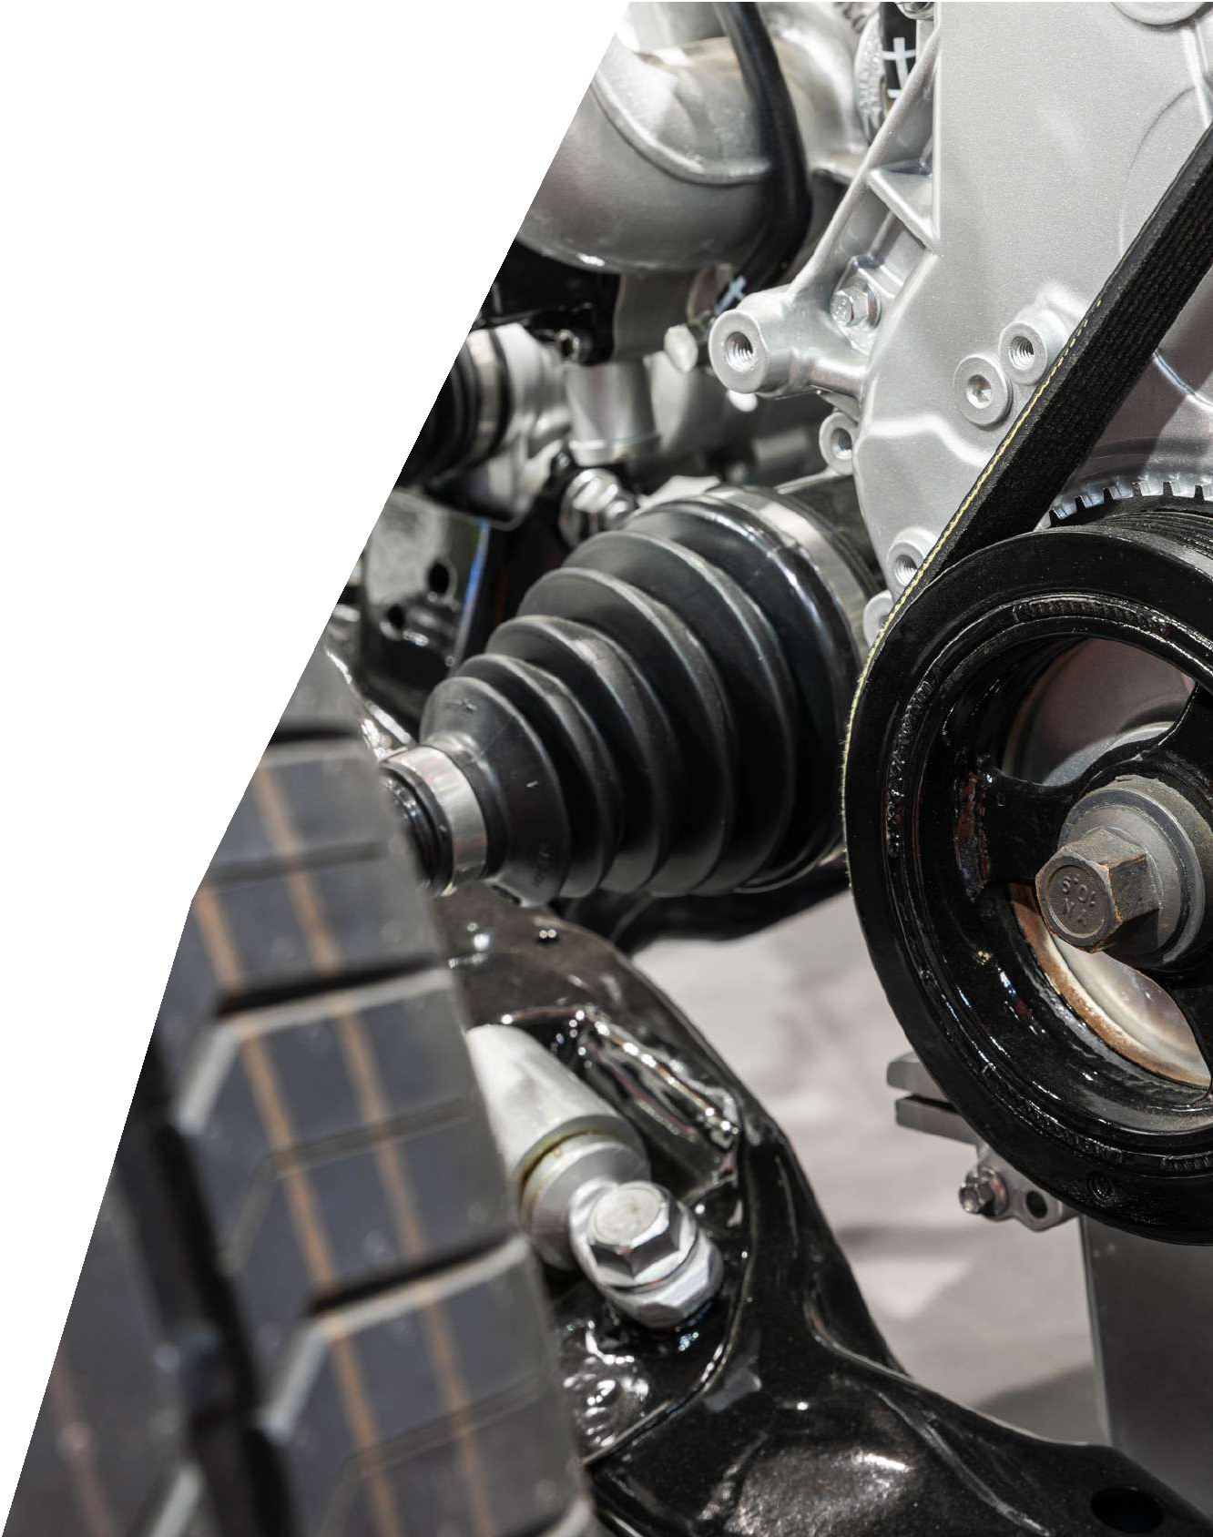
THANK YOU
F o r Y o u r A t t e n t i o n

